Slide 1

Dynamic Generation of Modular Industrial Plant Visualizations
Weekly Meeting 15
Miguel Romero Karam

Slide 2
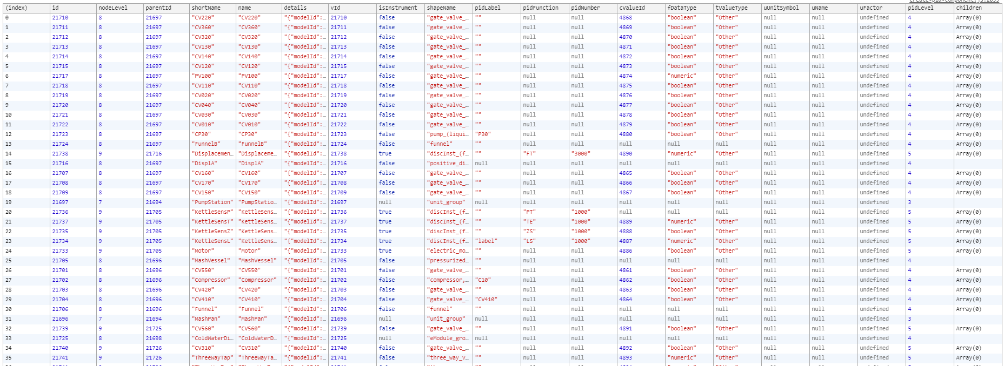
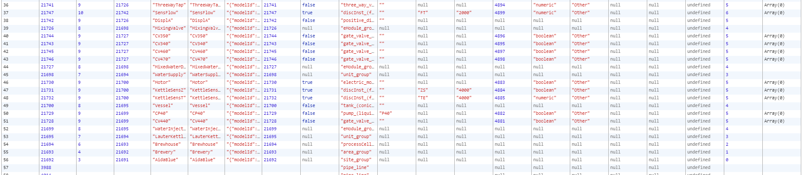

Slide 3
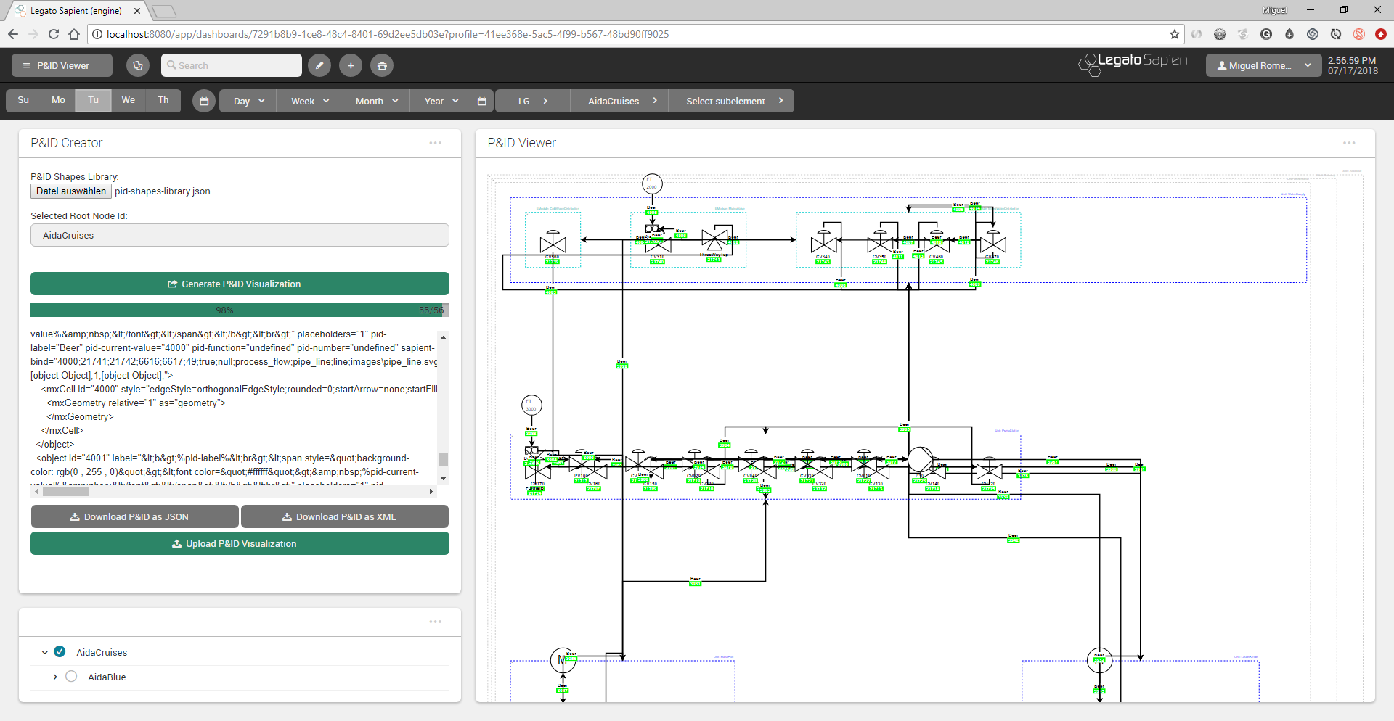
P&ID Viewer - Dashboard

Slide 4
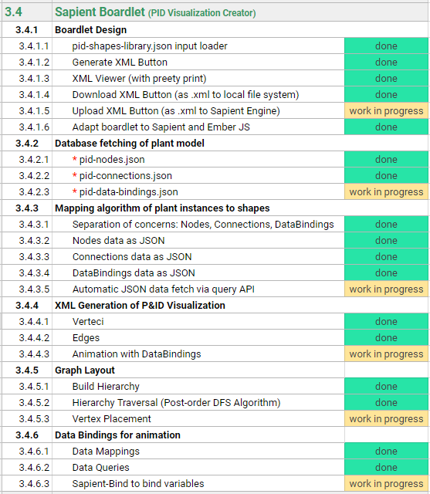
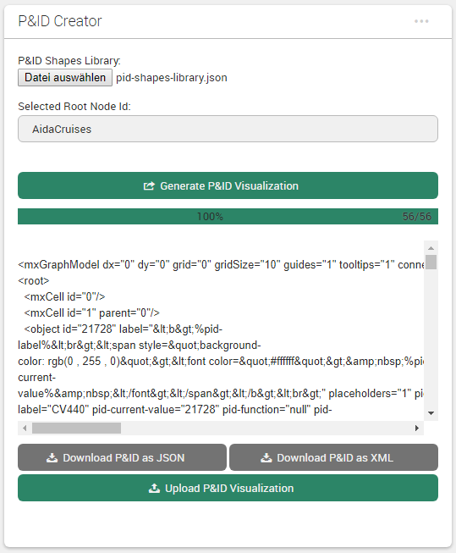
Sapient Boardlet Weekly Sprint 15

Slide 5
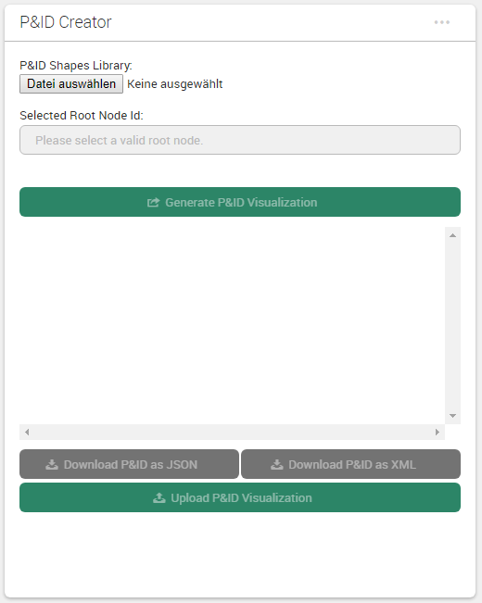
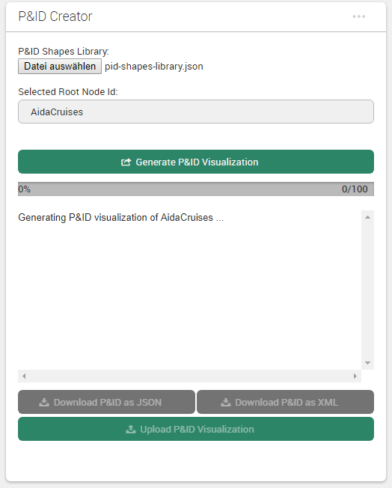
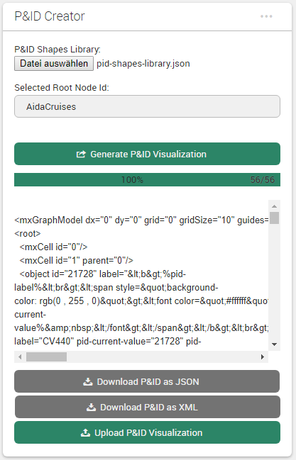
Boardlet Design Updates & Fixes
Implemented progress bar for vertex placement algorithm (can change to any function with iteration)
Fixed responsive layout of buttons when wrapped (narrow mobile screens)
1) on start
2) in progress
3) done
desktop
mobile

Slide 6
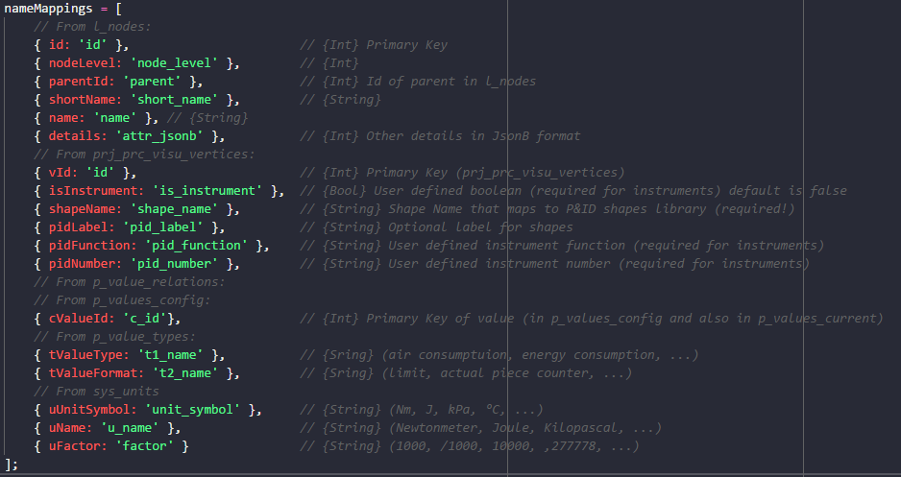
Variables for Vertices Name Mappings

Slide 7
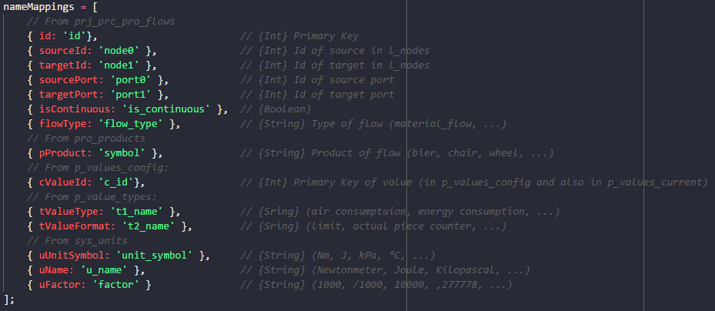
Variables for Connectzions Name Mappings

Slide 8
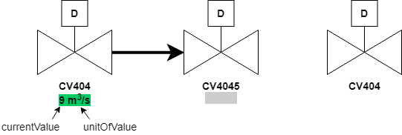
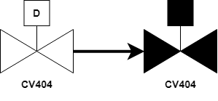
Data Bindings Overview
boolean (sets fillColor)
int (sets label) – concept because currently only bools
OR

Slide 9
Database Queries Overview Overview: Data Map
fetched
not needed (Legato Graphic Designer fetches current_values automatically with the ID) and current value will be the first non-blank value_[type] field
prj_prc_visu_vertices
l_nodes
p_value_relations
p_values_config
p_values_current
id [PK] : Int
id [PK] : Int
Maps to
id [PK] : Int
id [PK] : Int
id [PK] : Int
node : Int
node_level : Int
node: Int
value_type : Int
value_bool : Int
shape_name : String
node_type : Int
value: Int
value_format: Int
value_num : Double
is_instrument : Boolean
parent : Int
…
name: String
value_str : String
pid_label : String
short_name : String
value_symbol: String
value_date : Timestamp
pid_function : String
name : String
prj_prc_pro_flows
unit: Int
time_stamp : Timestamp
pid_number : String
description_0 : String
…
last_archive_id : Int
description_1 : String
id [PK] : Int
last_update : Timestamp
permissions : Int
node0 : Int
…
attr_jsonb : Jsonb
node1 : Int
name_0
modelId : Int
port0 : Int
p_value_types
isaLevel : String
port1 : Int
DoState
valPrefix : String
product : Int
AoState
id [PK] : Int
standingData: Array
is_continuous : Boolean
DiSens
name : String
opcUALevel : Int
rate_value : Int
AiSens
…
opcUANamespaceName : String
flow_type : String
AiValue
AiTemp
sys_units
opcUAAddressPrefix : String
…
sys_value_formats
id [PK] : Int
name_0
unit_symbol : String
numeric
id [PK] : Int
name : String
name_1 : String
factor : String
boolean
…
string
…
…
TODO
COMPARAR CON nameMappings en getData Y ACTUALIZAR SI HACE FALTA

Slide 10
lNodes and dataBindings Data Map of Query
not needed (Legato Graphic Designer fetches current_values automatically with the ID)
l_nodes
p_value_relations
p_values_config
p_values_current
id [PK] : Int
Maps to
id [PK] : Int
id [PK] : Int
id [PK] : Int
node_level : Int
node: Int
value_type : Int
value_bool : Int
node_type : Int
value: Int
value_symbol: String
value_num : Double
parent : Int
…
name_0: String
value_str : String
short_name : String
value_format: Int
value_date : Timestamp
name_0 : String
unit: Int
time_stamp : Timestamp
name_1 : String
…
last_archive_id : Int
description_0 : String
last_update : Timestamp
description_1 : String
…
permissions : Int
prj_prc_visu_vertices
attr_jsonb : Jsonb
p_value_types
modelId : Int
name_0
id [PK] : Int
isaLevel : String
node : Int
id [PK] : Int
valPrefix : String
DoState
shape_name : String
name_0 : String
standingData: Array
AoState
is_instrument : Boolean
…
opcUALevel : Int
DiSens
pid_label : String
opcUANamespaceName : String
AiSens
pid_function : String
opcUAAddressPrefix : String
AiValue
pid_number : String
…
AiTemp
lNodes query

Slide 11
pidNodes PostgreSQL Query
Complex PostgreSQL query for all data:
SELECT n.id, n.node_level AS nodeLevel, n.parent AS parentId, n.short_name AS shortName, n.name_0 AS name, n.attr_jsonb AS details,
v.id AS vId, v.is_instrument AS isInstrument, v.shape_name AS shapeName, v.pid_label AS pidLabel, v.pid_function AS pidFunction, v.pid_number AS pidNumber,
c.id AS cValueId,
t1.name_0 AS tValueType,
t2.name_0 AS tValueFormat,
u.unit_symbol_0 AS uUnitSymbol, u.name_0 AS uName, u.factor AS uFactor
FROM sapient_owner.l_nodes AS n
LEFT JOIN sapient_owner.prj_prc_visu_vertices AS v ON n.id = v.node
LEFT JOIN sapient_owner.p_value_relations AS r ON n.id = r.node
LEFT JOIN sapient_owner.p_values_config AS c ON r.value = c.id
LEFT JOIN sapient_owner.p_value_types AS t1 ON c.value_type = t1.id
LEFT JOIN sapient_owner.p_value_types AS t2 ON c.value_format = t2.id
LEFT JOIN sapient_owner.sys_units AS u ON c.unit = u.id
WHERE n.id >= 21691 AND n.id <= 21747
ORDER BY n.id ASC
UPDATE FOR ACTUAL QUERY

Slide 12
pidConnections Data Map of Query
l_nodes
prj_prc_pro_flows
id [PK] : Int
id [PK] : Int
node_level : Int
node0 : Int
node_type : Int
node1 : Int
parent : Int
port0 : Int
short_name : String
port1 : Int
name_0 : String
product : Int
name_1 : String
is_continuous : Boolean
description_0 : String
rate_value : Int
UPDATE FOR ACTUAL QUERY
description_1 : String
flow_type : String
permissions : Int
pidConnections query
attr_jsonb : Jsonb
modelId : Int
isaLevel : String
valPrefix : String
standingData: Array
opcUALevel : Int
opcUANamespaceName : String
opcUAAddressPrefix : String
…

Slide 13
pidConnections PostgreSQL Query
Complex PostgreSQL query for all data:
SELECT f.id, f.node0 AS sourceId, f.node1 AS targetId, f.port0 AS sourcePort, f.port1 AS targetPort, f.is_continuous AS isContinuous, f.flow_type AS flowType,
p.symbol AS pProduct,
c.id AS cValueId,
t1.name_0 AS tValueType,
t2.name_0 AS tValueFormat,
u.unit_symbol_0 AS uUnitSymbol, u.name_0 AS uName, u.factor AS uFactor
FROM sapient_owner.prj_prc_pro_flows AS f
LEFT JOIN sapient_owner.pro_products AS p ON f.id = p.id
LEFT JOIN sapient_owner.p_values_config AS c ON f.rate_value = c.id
LEFT JOIN sapient_owner.p_value_types AS t1 ON c.value_type = t1.id
LEFT JOIN sapient_owner.p_value_types AS t2 ON c.value_format = t2.id
LEFT JOIN sapient_owner.sys_units AS u ON c.unit = u.id
ORDER BY f.id ASC
UPDATE FOR ACTUAL QUERY

Slide 14
3. Vertex Placement Concept
Probleme:
Leere attribute
Führt zu Irreguläre Platzierung in die Mehrheit der Fälle → braucht zu viel Logik.
Relative positionierung deswegen manchmal suboptimal, aber trotzdem die beste Alternative
Viel Aufwand und wenig Fortschritt bei der Verbesserung des Algorithmus.
Lösungen (zum Teil):
Specification of Constraints erlaubt Logik gezielt zu programmieren
Constraints erlauben auch das progressive Enhancement
Block packing algorithm ist eine optimale Lösung für P&ID Diagramme falls alle children Gruppen sind (rechteckige Blocks). Nicht aber für shapes.

Slide 15
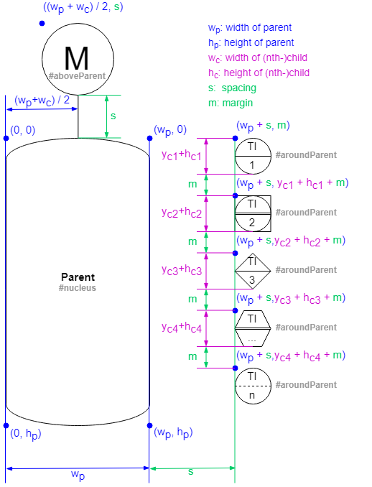
3.1 Placement Logic Example:
Kleine Modifikationen zum vorherigen Logik
Sonst gleich

Slide 16
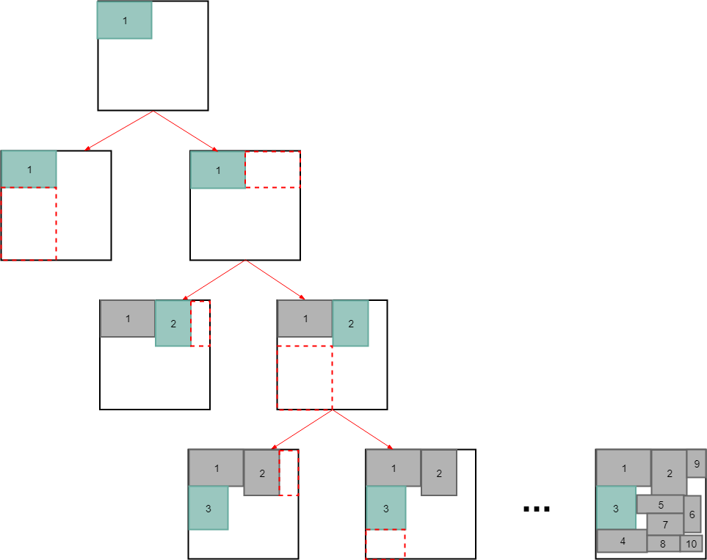
3.2 packBlocks() Overview
Binary tree block packing algorithm (for groups):
Sort blocks (clones) based on selected sortOrder option (none, width, height, area, maxSide)
Place first (root) block at (0, 0).
Place next block either right or bellow of previous (minimize area)
Repeat 3 until all blocks placed.
Update properties in original objects.
Sehr gute Ergebnisse für Blocks die nur Groupen sind (ohne Shapes)

Slide 17
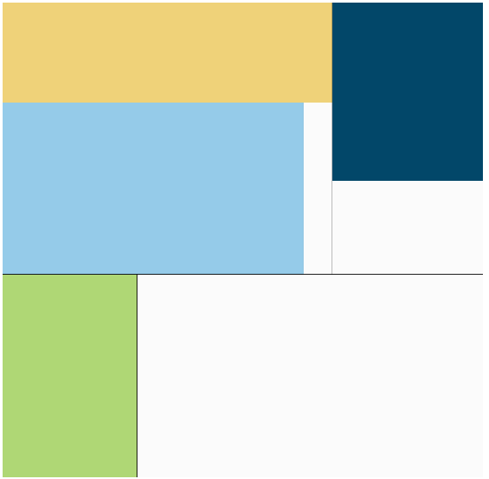
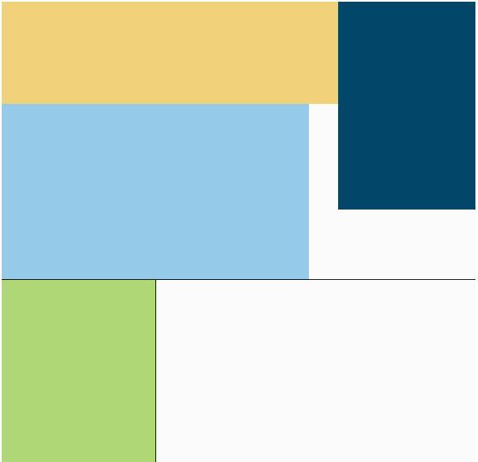
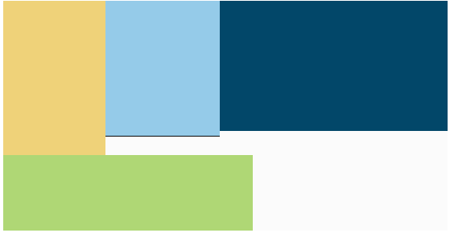
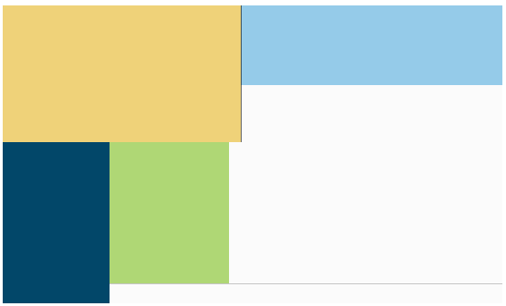
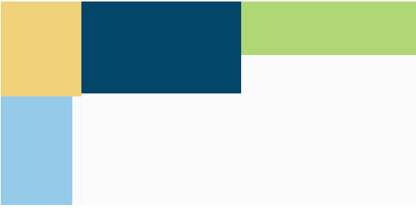
3.2 packBlocks() Sort Order Options
Beispiel mit 4 Units in Brewery (block dimensions to scale)
by height
none (default)
by area
by width
by maxSide

Slide 18
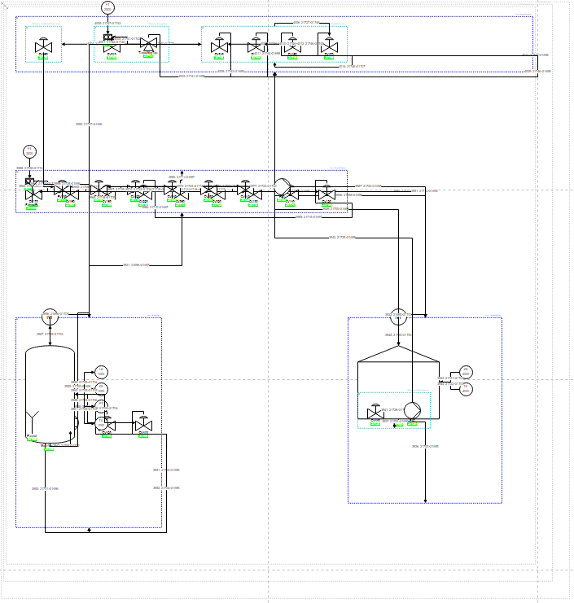
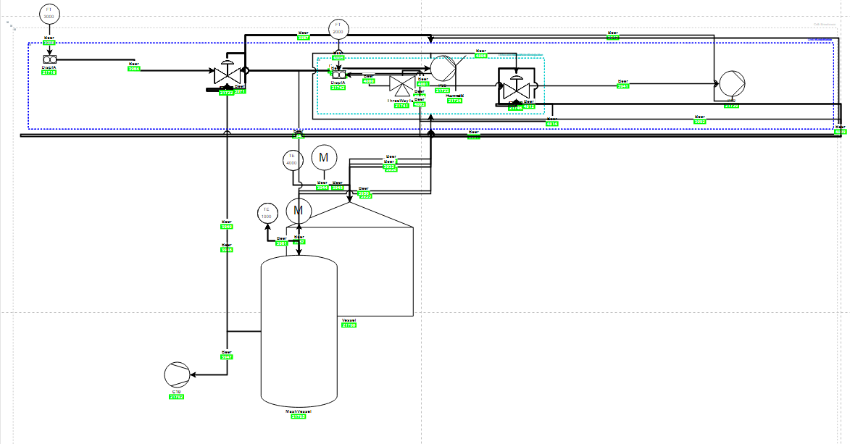
3.2 Bugs in Boardlet Algorithmus Sort Order Options
Obwohl praktish identische Code, nicht gleiche Visu Output.
Testing Boardlet Sapient Boardlet

Slide 19
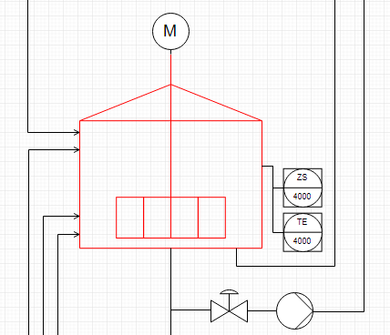

Vertex Placement Concept
Geometry between neighbouring children
$$x=w_{p}+s$$
y$=h_{p}−$ $h_{n}$
wn/2
Optimal Fall (vor ein Paar Wochen):
wp/2
(x, y)
hn/2
hp/2
(0, 0)
spacing
Hgmax (currently)
Wgmax (currently)
Relative Positioning
vertex placement group placement group placement … (recursively)
Parent vertex
(0, 0)
(-0.5,0.5)
(0.5, 0.5)
(1, 1)

Slide 20
3.3 Issues and Challenges Weekly Sprint 14
Stillstand beim vertexPlacement Algorithmus → fix bugs, then leave as is
Alles wofür es eine bestimmte Logik dahinter gibt, wird schon entsprechend dieser Logik platziert.
Nich viel mehr Logik um das Platzierungsalgorithmus in wenig Zeit noch zu verbessern.
Verbesserungen machen manchmal andere Teilen von Code kaputt.
Bugs im Algorithmus in Boardlet Script (nicht im Testing Boardlet).
Vorteile:
Konzentration auf Data-bindings (dynamisierung)
Verteci schon ziemlich gut platziert und edges vereinfacht
Verbesserungsmöglichkeiten direkt im draw.io (Drag&Drop)
Nachteile:
Platzierung ist das Endergebniss und alles was man am Ende sieht
Arbeit und Aufwand die hinter die Visualisierung sieht man nicht
Kann zu enttäuschenden Schlussfolgerungen bezüglich des Projekts führen
Bug wenn selectierte rootNode nicht AidaCruises → fix
Animations und Data Bindings
Process Variables noch nicht im Datenbank vorhanden → Animationen nur als Konzept
Model wird sowieso nur booleans enthalten → Konzept für andere Data Types oder nicht ?

Slide 21
Vorläufige Inhaltsverzeichnis Bachelorarbeit
In Word…

Slide 22
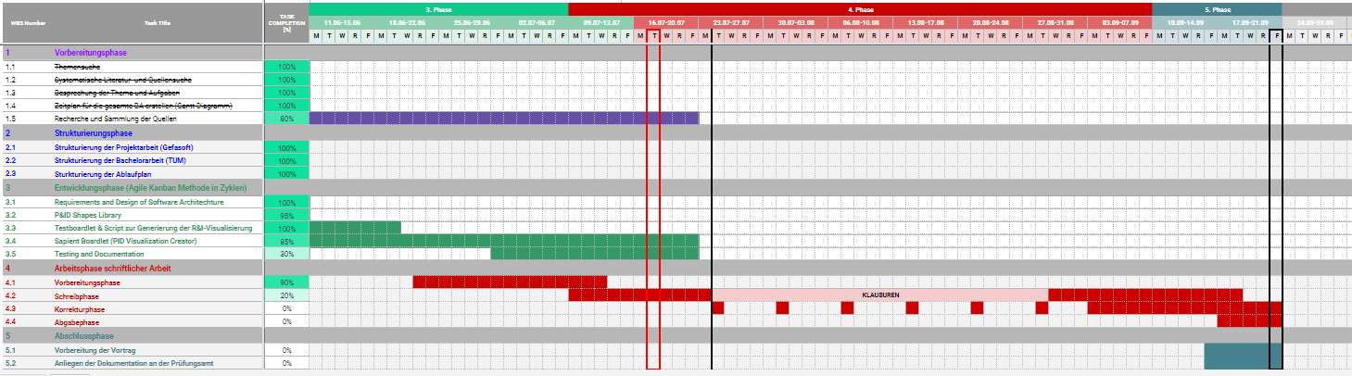
Project – Overview Overview of tasks: Week 10

Slide 23
forEach vertex in pidVertices:
if (not group):
calculate cell area
store cell area
position current vertex:
get previous vertex position (x, y values)
apply positioning rules
set current vertex position
update value of previous x, y values
else if (group):
sum areas of contained cells

